Slide 1
iOS Development Training
Prepared by: Glenn Von Posadas, ios Engineer

Slide 2

Summary
About me
Glenn Posadas
iOS Tech Lead @ Outliant
https://www.glennvon.com
Email: hello@glennvon.com

Slide 3
Welcome to day 1

Slide 4
GOALS
Day 1 GOALS
C Programming Language Fundamentals
Objective-C basics

Slide 5

Apple environment & ides

Slide 6
iOS
Day 1 - Extensive iOS App Development Training
Formerly known as iPhone OS. Became iOS in iOS 4.0.
Is a mobile operating system created and developed by Apple, Inc. exclusively for its hardware.
Powers iPhone, iPod touch, iPad (prior to iPadOS).
Major versions of iOS are released annually. Currently we’re in iOS 13.0.

Slide 7
Xcode
Day 1 - Extensive iOS App Development Training
Xcode is an integrated development environment for macOS containing a suite of software development tools developed by Apple for developing software for macOS, iOS, iPadOS, watchOS, and tvOS

Slide 8
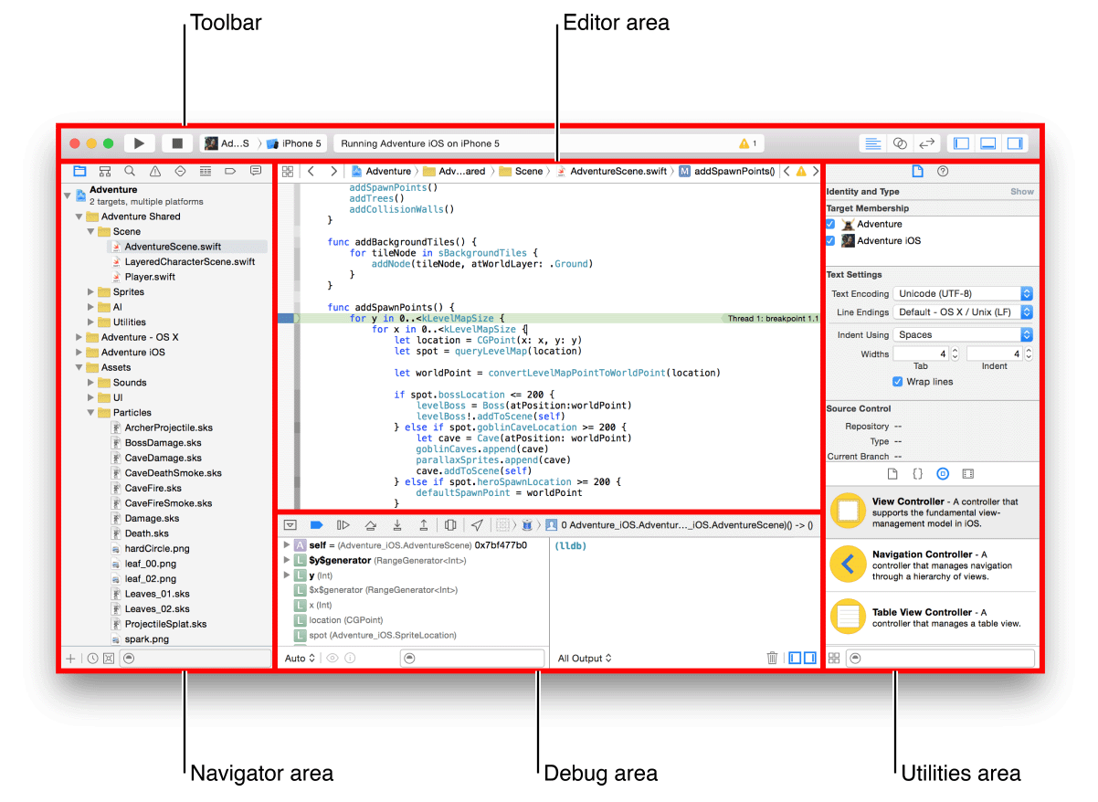
Meet the Xcode

Slide 9
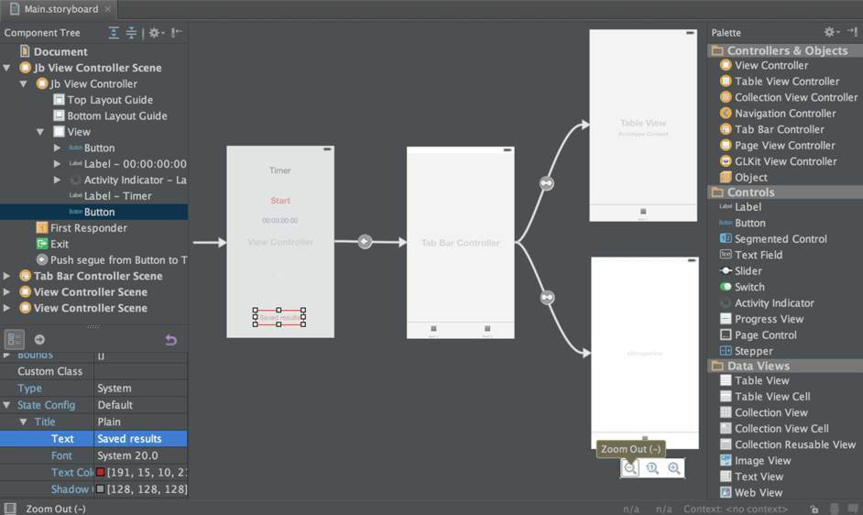

Slide 10
Simulators & templates

Slide 11
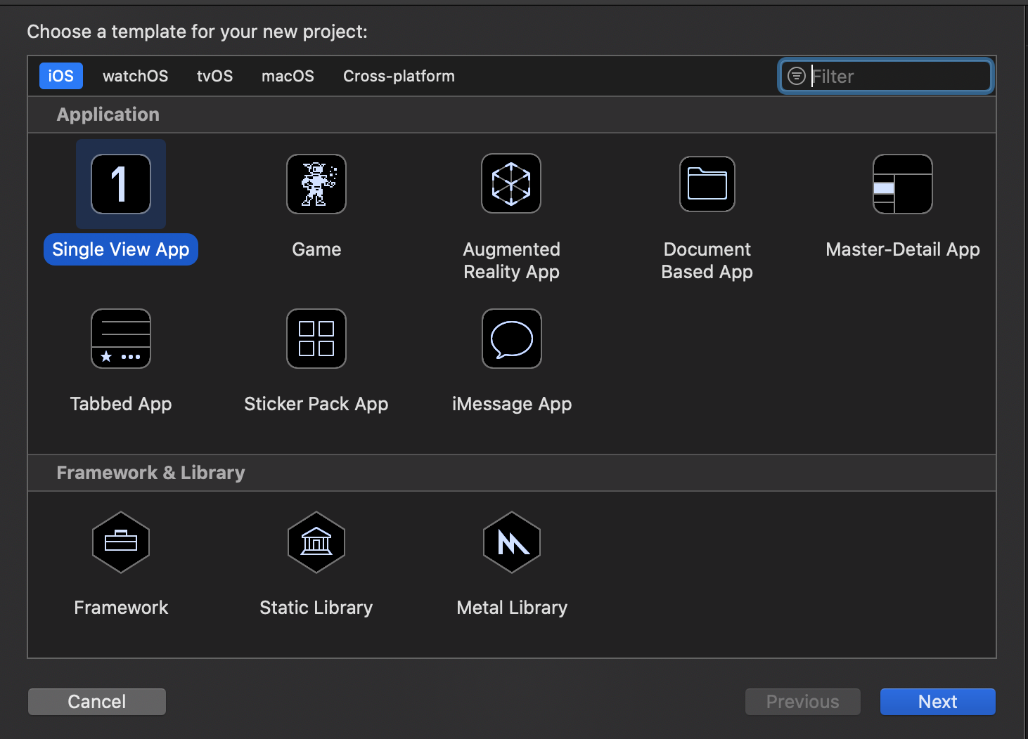

Slide 12
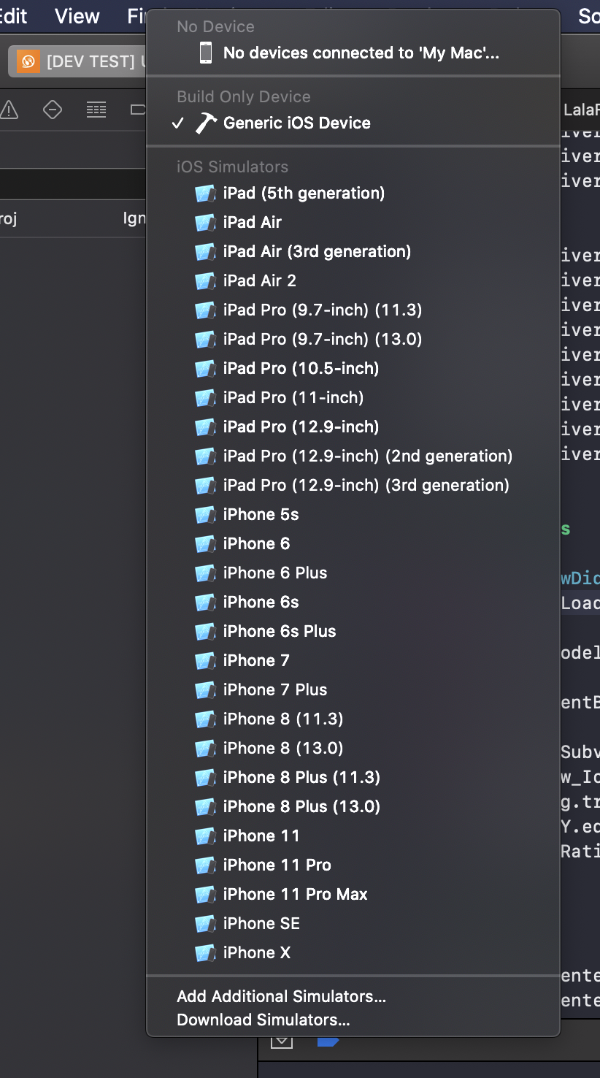

Slide 13
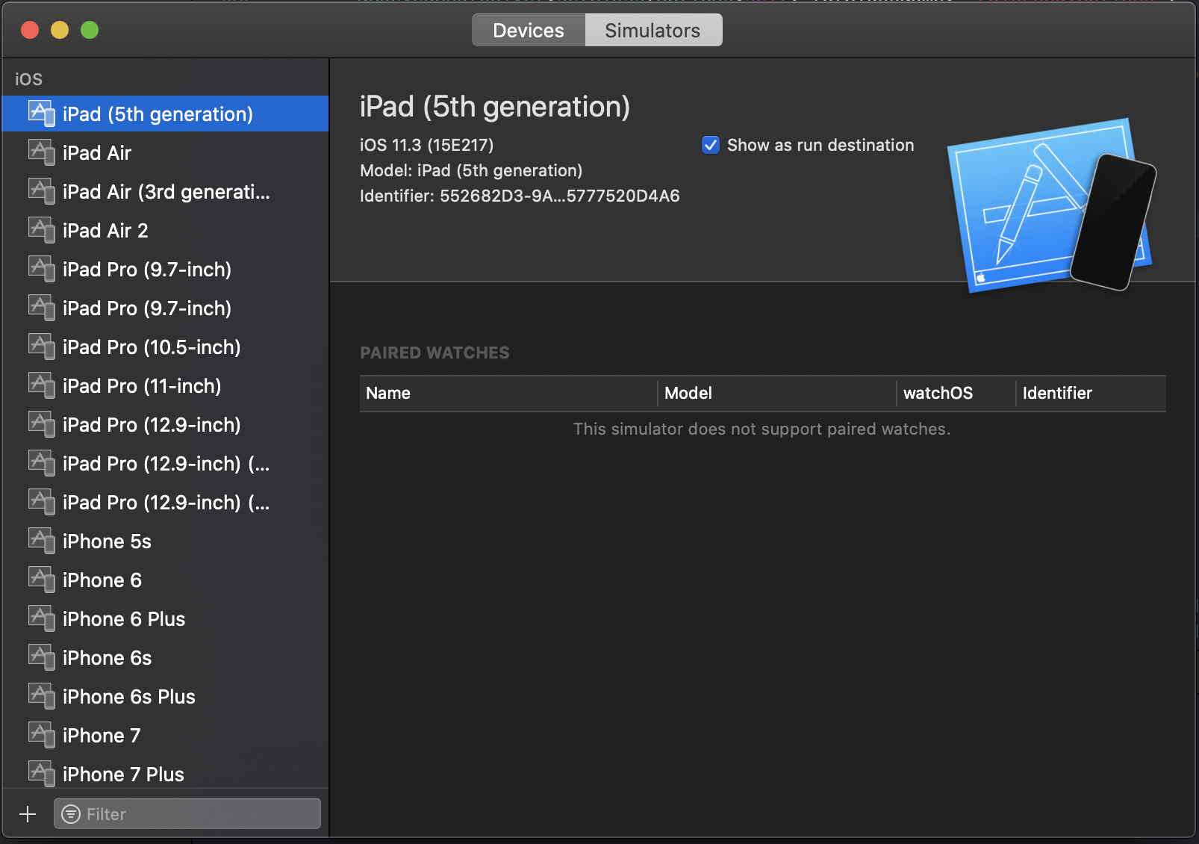

Slide 14

Fundamentals in c & objective-c programming language

Slide 15
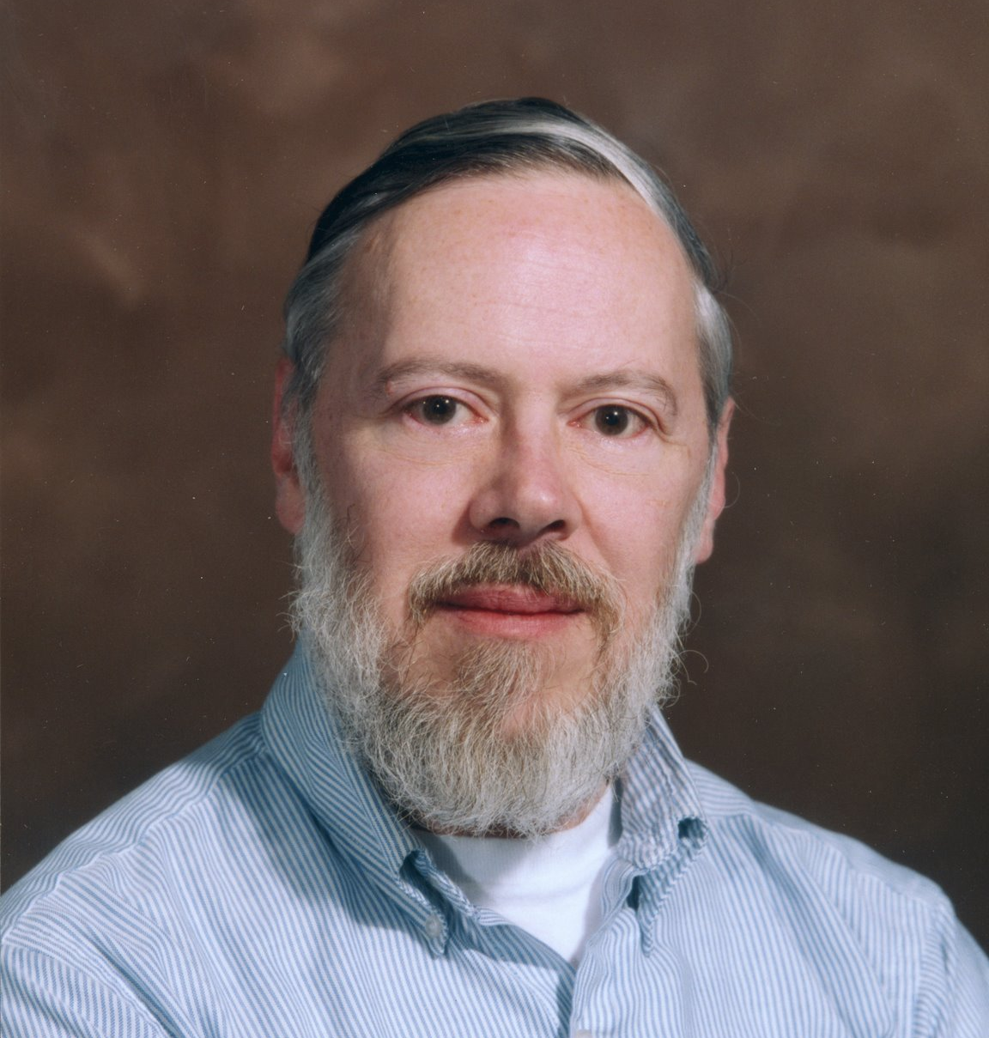
C Programming language
C programming language
C is a procedural programming language. It was initially developed by Dennis Ritchie between 1969 and 1973. It was mainly developed as a system programming language to write an operating system.
The main features of C language include low-level access to memory, a simple set of keywords, and clean style, these features make C language suitable for system programmings like an operating system or compiler development.

Slide 16
C fundamentals

Slide 17
C programming language
The following are simple examples to get things started. They do not do anything useful, but they illustrate some key characteristics of C.
/* this is a comment */
main() /* function definition */
{ /* start of block */
printf("Hello world\n"); /* output; statement ends with a semicolon */
/* use '\n' in printf to get a linefeed */
} /* end of block */
Things to note in example programs:
comments cannot be nested.
main() is the function where the program begins execution, and can only occur once.
C is case specific.
all white space (spaces, tabs, blank lines, comments) is equivalent to one space.

Slide 18
C programming language
main()
{
int x; /* declaration and definition */
x=5; /* assignment */
printf("%d\n", x); /* output x as an integer */
}
main()
{
int x=17, y=12, z; /* declaration, definition, and initialization */
z = x + y; /* arithmetic expression */
printf("z = %d + %d = %d\n", x, y, z); /* each %d prints one integer */
printf("%d * %d = %d\n", x, y, x*y);
}

Slide 19
C programming language
main()
{
int x;
scanf("%d", &x); /* values input from the keyboard using scanf(): */
printf("x = %d\n", x); /* and a pointer to x */
}
A common error when using scanf() is not giving pointers as the arguments;
to input a variable, use
int x;
scanf("%d", &x); /* correct */
// NOPE
int x;
scanf("%d", x); /* incorrect */

Slide 20
Variables
C programming language
All variables must be declared and defined before they can be used.
Variable names can be composed of characters, digits, and the underscore character ( _), and can usually be up to 32 characters long.
Variable names should not begin with an underscore---these names are used by the compiler and the libraries.

Slide 21
Variables
C programming language
Variables have specific types and usage; basic data types:
char: a single byte, used for one character.
can specify signed or unsigned, although signed is preferred for compatibility with int
int: integers
can modify with short or long
can specify signed or unsigned
float: single precision floating point (real) number
double: double precision floating point number void: no type value, for pointers and functions
The specific size of each type depends on the implementation; see <limits.h> for details. On Unix systems, <limits.h> is usually the file /usr/include/limits.h.

Slide 22
C programming language
Derived Data Types
arrays (array[10])
pointers (*pointer)
functions (function())
structures (structure.member)
enumerated (enumerated_variable)
union (union_name.member)

Slide 23
C programming language
All variables must be declared and defined; they can also be initialized and assigned a value.
declaration: specifies the type of the identifier
definition: reserves storage space for the object
initialization: gives an initial value to the object during definition
assignment: gets a new value

Slide 24
C programming language
/*** definition of constants ***/
main()
{
char c = 'x';
char c1 = '0'; /* the character 'zero', with the integer value for ASCII(0) */
char c2 = '\0'; /* has the "integer" value zero */
int n = 10;
int n_oct = 065; /* octal */
int n_hex = 0x3d; /* hexadecimal */
long m = 10L;
unsigned int k = 304U;
unsigned long l = 3040UL;
float x1 = 143.0;
float x2 = 24.6e-3;
double y = 34.1L;
}

Slide 25
Input / output
C programming language
Basic input/output is obtained using the standard library. The syntax is given below.
printf("control string", variable1, variable2, ...);
scanf("control string", &pointer1, &pointer2, ...);

Slide 26
C programming language
The control string has place holders for the variables being used.
There can also be characters in the control string.
For scanf(), the pointers to the variables being inputed must be used.
/** using printf() and scanf() **/
main()
{
int x=10;
float y;
printf("(1) %d\n", x);
printf("(2) %d\n", x*5);
printf("(3) x = ");
printf("%d", x);
printf("\n"); /** same as (4) **/
printf("(4) x = %d\n", x); /** same as (3) **/
printf("input x: "); scanf("%d", &x); /** prompts for input **/
printf("(5) x = %d\n", x);
/** can input several values of different types with one scanf command **/
printf("input x, y: "); scanf("%d %f", &x, &y);
printf("(6) x = %d, y = %f\n", x, y);
}

Slide 27
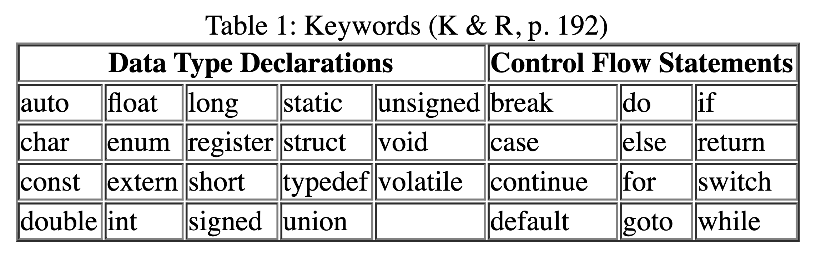
Keywords and operators
C programming language
C has a small set of keywords; all are used to either declare data types or control the flow of the program.

Slide 28
Basic operators
C programming language
Arithmetic Operators
*, / , %, +, -
% is called modulus division (remainder)
Logical Operators
<,>, <=, >=, ==, !=, &&, ||
the logical operators return a 1 (true) or 0 (false)
for any conditional test, any non-zero value is true and a 0 is false
== is the equality comparison ( not =)
!= not equal to
&&, || logical AND and OR operators
A common error is using the assignment operator = when the logical operator == is required, e.g. (x = 2) instead of (x == 2); both are valid expressions, so the compiler will not indicate an error

Slide 29
Basic operators
C programming language
Assignment Operators
=, +=, -=, *=, /=, %= !
op= assignment, E1 op=E2 <==> E1=E1 op (E2) with E1 evaluated once.
for example, x+=2 ==>x=x+2
increment/decrement by 1, as a prefix or postfix
++, —
prefix: increments the variable and gives the new value as the result
postfix: gives the old value as the result and then increments the variable
Negation
!
!(0) ==> 1
!(any non zero value) ==> 0

Slide 30
Basic operators
C programming language
Conditional, compact if-else as an expression instead of a statement
?
(type)
casts object into a different type
, (comma)
combines separate expressions into one
evaluates them from left to right
the value of the whole expression is the value of the right most sub-expression

Slide 31
Type conversion
C programming language
C does some automatic type conversion if the expression types are mixed. If there are no unsigned values, the rules for conversion for two operands are:
if any long double, convert other to long double
else if any double, convert other to double
else if any float, convert other to float
else
convert any char or short to int
if any long, convert other to long
Any explicit type conversions can be made by casting an expression to another type, using (double), (float), etc., before the expression to be cast.

Slide 32
Type conversion
C programming language
int main()
{
int x=8, y=10;
float z1, z2;
z1 = x/y;
z2 = (float) x / (float) y;
printf("z1 = %6.2f, z2 = %6.2f\n", z1, z2);
}

Slide 33
Expressions and statements
C programming language
Expressions include variable names, function names, array names, constants, function calls, array references, and structure references. Applying an operator to an expression is still an expression, and an expression enclosed within parentheses is also an expression.
A statement is:
a valid expression followed by a semicolon
a group of statements combined into a block by enclosing them in braces {}. This is then treated as a single statement.
a special statement (break, continue, do, for, goto, if, return, switch, while,} and the null statement)
A statement can be labeled, for use with goto. Since goto disrupts structured control flow, however, it is not generally recommended.

Slide 34
Control flow
C programming language
Basic control flow is governed by the if..else, while,do...while, and for statements.

Slide 35
Decision making
C programming language
Use the if...else for conditional decisions. (exp is any valid expression, statement is any valid statement)
main() /*** check if a number is odd or even ***/
{
int i;
scanf("%d", &i);
if (i%2 == 0) /** OR if (!(i%2)) **/
printf("i is even\n");
else
printf("i is odd\n");
}

Slide 36
Looping
C programming language
while: testing at the beginning of the loop
do...while: testing at the end of the loop, after executing the loop at least once
for: almost the same as while, in a compact form

Slide 37
Other control flow
C programming language
Other program control flow is governed by the switch statement, which allows comparison to a series of constant values, and the goto, continue, break, and return statements.
/** Example with 'do...while' and 'switch': waiting for a yes/no answer **/
main()
{
char ans, c;
int answer;
do
{
printf("enter y/n: "); scanf("%c", &ans);
switch (ans)
{
case 'y': case 'Y': answer = 1; break;
case 'n': case 'N': answer = 0; break;
default: answer = -1; break;
}
} while (answer == -1);
printf("answer = %d\n", answer);
}

Slide 38
C preprocessor
C programming language
Two essential preprocessor commands are #define and #include. Constants and macros are defined with #define. The program can be split into separate files and combined with #include, and header files can also be inserted.
#include <stdio.h>
#include <math.h>
#include "functions.c"
#define MAX 10
#define TRUE 1
#define FALSE 0

Slide 39
C preprocessor - math.h
C programming language
/** program to calculate x using the quadratic formula **/
#include <math.h>
main()
{
float a, b, c, d, x, x1, x2;
printf("input a, b, c: ");
scanf("%f %f %f", &a, &b, &c);
d = b*b - 4.0*a*c;
if (d >= 0) /** check if solution will be real or complex **/
{
x1 = (-b+sqrt(d)) / (2.0*a); /** sqrt() from the math library **/
x2 = (-b-sqrt(d)) / (2.0*a);
/** need parentheses for proper order of operations **/
printf("x = %f, %f\n",x1,x2);
}
else
printf("x is complex");
}

Slide 40
#if #endif
C programming language
The #if...#endif preprocessor command can be used to comment out a section of code which may have comments within it.
/** using #if for nested comments **/
#define TRUE 1
#define FALSE 0
main()
{
int x=5;
printf("x = %d\n", x);
#if FALSE /** everything until the matching #endif is commented **/
x = 304;
#endif
printf("x = %d\n", x);
}

Slide 41
Programming problem
C programming language
Write a program that asks for input for Fahrenheit variable F and convert it to Celsius and print it out. Using the conversion
C = (F-32)*5/9

Slide 42
Functions

Slide 43
Functions
C programming language
Reasons for using functions:
saves repetition of common routines
functions can be used by different parts of the program
modularizes the program, making it easier to use
allows recursive processes

Slide 44
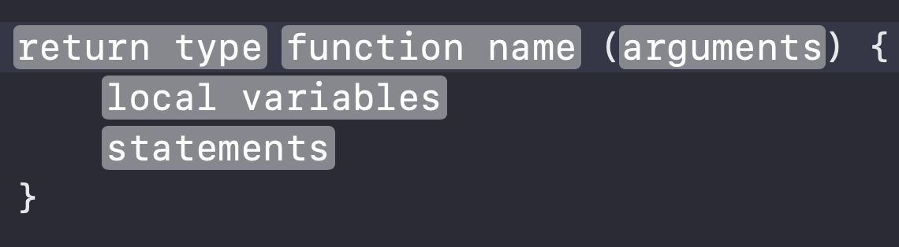
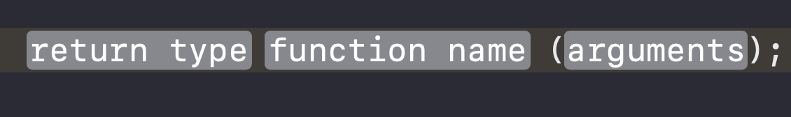
Basic structure
C programming language
The function prototype is a declaration and is needed if the function is defined after its use in the program. The syntax is:

Slide 45
Basic structure
C programming language
If the function is defined before its use, then a prototype is not necessary, since the definition also serves as a declaration.
If the return-type is omitted, int is assumed. If there are no argument declarations, use void, not empty parentheses.

Slide 46
How functions can be used?
C programming language
A function that has no arguments and does not return a value:
void print_message(void)
{
printf("hello\n");
}
main()
{
print_message();
}

Slide 47
How functions can be used?
C programming language
A function that takes an argument.
The arguments are separated by commas; the order in which they are evaluated is unspecified. The value of each argument is passed to the corresponding parameter of the function
void print_integer(int i)
{
printf("i = %d\n", i);
}
main()
{
int n=5;
print_integer(n);
}

Slide 48
How functions can be used?
C programming language
A function that returns a value
int input_integer(void); /** function prototype declarations **/
main()
{
int x, y, z;
x = input_integer();
y = input_integer();
printf("the sum is %d\n", z=x+y);
}
int input_integer(void)
{
int a;
do
{
printf("input a positive integer: ");
scanf("%d", &a);
} while (a <= 0);
return a;
}

Slide 49
How functions can be used?
C programming language
A function that takes an argument m and returns a value:
main()
{
int x, y, z=100;
int input_integer_le_n(int n); /** prototype declaration can be **/
/** inside a function **/
x = input_integer_le_n(z);
y = input_integer_le_n(z);
printf("the sum is %d\n", x+y);
}
int input_integer_le_n(int n)
{
int a;
do
{
printf("input a positive integer less than %d: ", n);
scanf("%d", &a);
} while (a<=0 || a>n);
return a;
}

Slide 50
Return statement
C programming language
A function can return a value of any type, using the return statement,
Syntax:
return exp;
return (exp);
return;
The return statement can occur anywhere in the function, and will immediately end that function and return control to the function which called it. If there is no return statement, the function will continue execution until the closing of the function definition, and return with an undefined value.

Slide 51
Ansi-c vs traditional c
C programming language
If the function return type is not int, it must be specified by the function prototype declaration.
This is done differently in ANSI C and "Traditional C." For a function returning the maximum of two numbers, the ANSI-C function would be

Slide 52
Ansi-c
C programming language
float max(float x, float y);
/* OR: float max(float, float); */
/** variable names {x,y} are not necessary, only the types **/
/** are, but using the names makes the code more readable **/
main()
{
float x,y,z;
...
z = max(x,y);
...
}
float max(float x, float y) /** argument types are in the definition **/
{
if (x < y)
return y;
else
return x;
}

Slide 53
Traditional c
C programming language
float max(); /** argument types are not included in the declaration **/
main()
{
float x,y,z;
...
z = max(x,y); /** the function call is the same **/
...
}
float max(x,y)
float x,y; /** argument types listed after the definition **/
{
if (x < y)
return y;
else
return x;
}

Slide 54
Object Storage Classes and Scope
C programming language
Functions, as with any compound statement designated by braces {}, have their own scope, and can therefore define any variables without affecting the values of variables with the same name in other functions. To be able to affect the variables, they can be made "global" by defining them externally.
Available storage classes for variables are:
automatic: declared when entering the block, lost upon leaving the block; the declarations must be the first thing after the opening brace of the block
static: the variable is kept through the execution of the program, but it can only be accessed by that block
extern: available to all functions in the file AFTER the declaration; use extern to make the variable accessible in other files
register: automatic variable which is kept in fast memory; actual rules are machine-dependent, and compilers can often be more efficient in choosing which variables to use as registers.

Slide 55
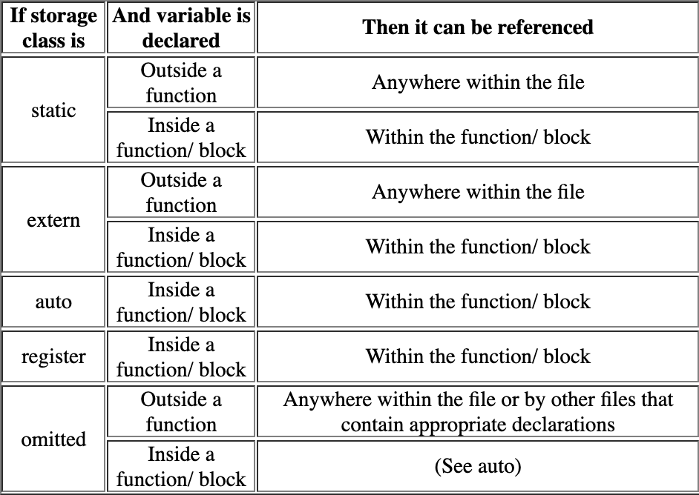
Object Storage Classes and Scope
C programming language

Slide 56
Macros
C programming language
Small procedures like swap() and max() can also be written as macros using #define

Slide 57
Macros
C programming language
#define MAX(x,y) ((x) > (y) ? (x) : (y))/** macro for maximum **/
float max(float x, float y) /** function for maximum **/
{
return (x>y ? x : y);
}

Slide 58
Programming problem
C programming language
Write a function to raise a number to an integer power, x_to_int_n(x,n)

Slide 59
Pointers
C programming language
A pointer is a variable whose value is the address of some other object. This object can have any valid type: int, float, struct, etc. The pointer declaration syntax is type *ptrName;

Slide 60
Pointers
C programming language
A pointer to an integer is declared as int *p;
where `p' is of type `int *', pointer to an integer, and `*p' is of type integer.
The type of object the pointer references must be specified before a value can be obtained. The operators used with pointers are the pointer reference/indirection (*) and address (&) operators

Slide 61
Pointers
C programming language
main()
{
int x, *px; /* defines the pointer px */
px = &x; /* &x ==> address of x */
*px = x; /* *px ==> value px points to */
}
where the value of px is the address of x, and *px is equivalent to x.

Slide 62
Wait a sec, where do we use pointers? 🤔
C programming language
void swap(int* x, int* y)
{
int temp = *x;
*x = *y;
*y = temp;
}
int main()
{
int x = 10, y = 20;
swap(&x, &y);
printf("%d %d\n", x, y);
return 0;
}
1. To pass arguments by reference
Passing by reference serves two purposes
To modify variable of function in other. (see example ->)
For efficiency purpose
Example passing large structure without reference would create a copy of the structure

Slide 63
Wait a sec, where do we use pointers? 🤔
C programming language
2. For accessing array elements.
Compiler internally uses pointers to access array elements
int main()
{
int arr[] = { 100, 200, 300, 400 };
// Compiler converts below to *(arr + 2).
printf("%d ", arr[2]);
// So below also works.
printf("%d\n", *(arr + 2));
return 0;
}

Slide 64
Wait a sec, where do we use pointers? 🤔
C programming language
3. To return multiple values
Example returning square and square root of numbers
// C program to demonstrate that using a pointer
// we can return multiple values.
#include <math.h>
#include <stdio.h>
void fun(int n, int* square, double* sq_root)
{
*square = n * n;
*sq_root = sqrt(n);
}
int main()
{
int n = 100;
int sq;
double sq_root;
fun(n, &sq, &sq_root);
printf("Square of %d and Sqrt of %d is %d %f\n", n, n, sq, sq_root);
return 0;
}

Slide 65
Wait a sec, where do we use pointers? 🤔
C programming language
4. Dynamic memory allocation
5. To implement data structures.
6. To do system level programming where memory addresses are useful
For example shared memory used by multiple threads.

Slide 66
Arrays
C programming language
An array is a contiguous space in memory which holds a certain number of objects of one type. The syntax for array declarations is
type array-name[const-size];
static type array-name[const-size] = initialization-list;
static type array-name[] = initialization-list;

Slide 67
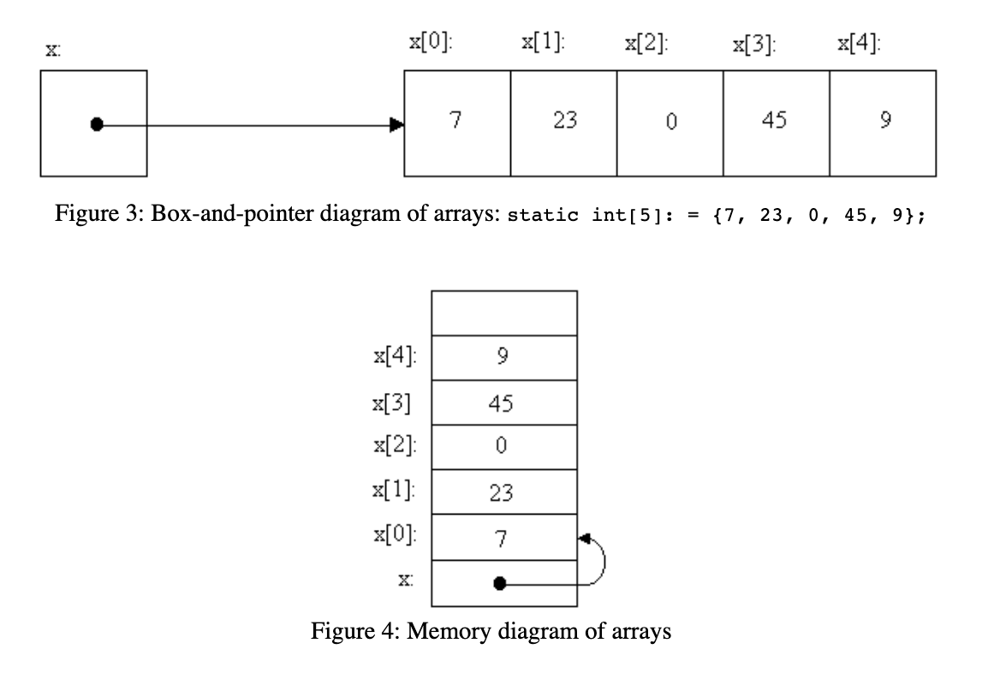
Arrays
C programming language
An array of 10 integers is declared as
int x[10]; with index values from 0 to 9.
where the remaining five elements of x[10] will automatically be 0.
static int x[5] = {7,23,0,45,9};
static int x[] = {7,23,0,45,9};
static int x[10] = {7,23,0,45,9,0,0,0,0,0};
static int x[10] = {7,23,0,45,9};

Slide 68
Arrays
C programming language
The array and pointer are closely related, in that x[i] and *(x+i) both get the i+1 element in the array.
There are differences between them, however. An array name is a constant, while a pointer is a variable, so
int x[10], *px;
px = x; px++; /** valid **/
x = px; x++; /** invalid, cannot assign a new value **/

Slide 69
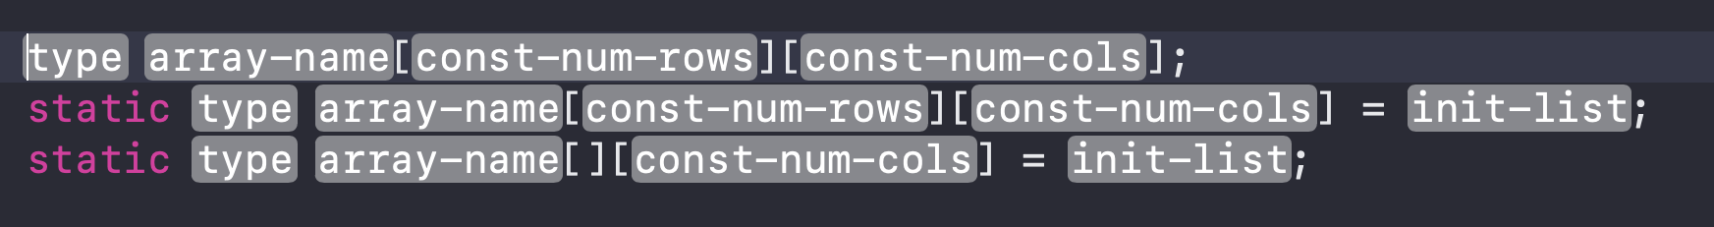
Multidimensional array
C programming language
A multidimensional array can be defined and initialized with the following syntax:.
static int x[][3] = {{3, 6, 9}, {4, 8, 12}}; /* static--can be initialized */
static int y[2][3] = {{3},{4}}; /* OR {{3,0,0},{4,0,0}} */
main()
{
int z[2][3];
printf("%d\n", x[1][2]); /** output: 12 **/
}

Slide 70
Multidimensional array
C programming language
When passing a two-dimensional array to a function, it can be be referenced in four ways:
**y, as a pointer to a pointer;
*y[], an array of pointers;
y[][COL], an array of arrays, unspecified number of rows; or
y[ROW][COL], an array of arrays, with the size fully specified.

Slide 71
Strings
C programming language
Strings are simply character arrays,
or more accurately, pointers to characters.
A string literal is enclosed within quotes,"...", and is an array with those characters and `0' at the end, so "hello" <==> {'h','e','l','l','o','\0'}.
The string can be defined as static char *p = “hello"

Slide 72
Programming problem
C programming language
Write a program to input two matrices, add and multiply them, and print the resulting matrices

Slide 73
struct
C programming language
A structure is a data type which puts a variety of pieces together into one object. The syntax is given below.
struct <#structName#> {
<#member-declarations#>
<#structure-names-opt#>
}
struct <#structName#> <#structure-instance-name#>;
<#structure-instance-name#>.<#property#> = <#val#>;

Slide 74
struct
C programming language
struct time
{
int hour;
int minute;
int second;
} now;
int main()
{
struct time later;
now.hour = 10;
now.minute = 30;
now.second = 4;
later = now;
printf("the later time is %d:%2d:%2d\n", later.hour, later.minute, later.second);
}

Slide 75
struct
C programming language
struct time
{
int hour, minute, second;
} ;
struct date
{
int month, day, year;
} ;
struct dt
{
struct date d;
struct time t;
} ;
main()
{
struct dt start_class;
start_class.d.month = 1;
start_class.d.day = 5;
start_class.d.year = 93;
}
Structure members can be other structures. For example,

Slide 76
typedef
C programming language
typedef defines a new type, which can simplify the code. Here is the syntax:
typedef data-type TYPE-NAME;
typedef struct structure-tag TYPE-NAME;
typedef struct
{
member-declarations
} TYPE-NAME ;

Slide 77
typedef
C programming language
#include <stdio.h>
#include <string.h>
typedef struct Books {
char title[50];
char author[50];
char subject[100];
int book_id;
} Book;
int main( ) {
Book book;
strcpy( book.title, "C Programming");
strcpy( book.author, "Nuha Ali");
strcpy( book.subject, "C Programming Tutorial");
book.book_id = 6495407;
printf( "Book title : %s\n", book.title);
printf( "Book author : %s\n", book.author);
printf( "Book subject : %s\n", book.subject);
printf( "Book book_id : %d\n", book.book_id);
return 0;
}

Slide 78
Array of structs
C programming language
An array of structures can also be defined.
struct date
{
int month, day, year;
};
typedef struct date DATE;
main()
{
int i;
DATE birthdays[10], *bday;
bday = birthdays; /*** pointer <==> array name ***/
for (i=0; i<10; i++, bday++)
scanf("%d %d %d", &bday->month, &((*bday).day), &birthdays[i].year);
for (i=0, bday = birthdays; i<10; i++, bday++)
printf("%2d/%02d/%2d\n", bday->month, bday->day, bday->year);
}
/*** the %02d pads the field with 0s, not spaces ***/

Slide 79
Use with functions
C programming language
Structures can be used with functions. Just as with other data types, either the structure or a pointer to the structure can be passed to the function. The choice should be based on three things,
1. does the structure need to be changed by the function,
2. is the structure small enough that copying it as a local argument will not affect performance,
3. does compatibility with old compilers require using pointers to the structures.

Slide 80
Use with functions
C programming language
#include <stdio.h>
// my struct
typedef struct {
int age;
char *name;
} Student;
// prototype
void greet(Student s);
int main(int argc, const char * argv[])
{
// first student
Student glenn;
glenn.age = 23;
glenn.name = "Glenn";
greet(glenn);
// second student
Student diana;
diana.age = 25;
diana.name = "Diana";
greet(diana);
}
void greet(Student s)
{
printf("Hi %c. You are %d years old!", s.name, s.age);
}

Slide 81
Union
C programming language
With union, different types of values can be stored in the same location at different times. Space is allocated to accommodate the largest member data type. They are syntactically identical to structures, Syntax:
union union-tag-opt
{
member-declarations
} union-names-opt;
union-name.member
ptr-to-union->member

Slide 82
Union
C programming language
/** a simple example with unions **/
union union_ifd /** can store either an integer, float, or double value **/
{
int ival;
float fval;
double dval;
} ;
main()
{
union union_ifd u1;
u1.ival = 10;
printf("%d\n", u1.ival);
u1.fval = 10.34;
printf("%f\n", u1.fval);
u1.dval = 10.03454834;
printf("%.10lf\n", u1.dval);
}

Slide 83
Struct vs union
C programming language
struct s_tag
{
int a;
long int b;
} x;
union u_tag
{
int a;
long int b;
} y;
The deference is in memory allocation.
Explanation: In structure, memory space will be created for all members inside structure.
In union memory space will be created only for a member which needs largest memory space.
Consider the following code:
Here there are two members inside struct and union: int and long int. Memory space for int is: 4 byte and Memory space for long int is: 8 in 32 bit operating system.
So for struct 4+8=12 bytes will be created while 8 bytes will be created for union

Slide 84
Struct vs union
C programming language
#include<stdio.h>
struct s_tag
{
int a;
long int b;
} x;
union u_tag
{
int a;
long int b;
} y;
int main()
{
printf("Memory allocation for structure = %d", sizeof(x));
printf("\nMemory allocation for union = %d", sizeof(y));
return 0;
}

Slide 85
Enum
C programming language
The type enum lets one specify a limited set of integer values a variable can have. For example, flags are very common, and they can be either true or false.
The values of the enum variable are integers, but the program can be easier to read when using enum instead of integers. Other common enumerated types are weekdays and months.
The enumerated values can be set by the compiler or set explicitly. If the compiler sets the values, it starts at 0 and continues in order. If any value is set explicitly, then subsequent values are implicitly assigned.

Slide 86
Enum
C programming language
#include <stdio.h>
// gender in enum
typedef enum {
FEMALE,
MALE
} Genders;
// my struct
typedef struct {
int age;
char *name;
Genders gender;
} Student;
// prototype
void greet(Student s);
int main(int argc, const char * argv[]) {
// first student
Student glenn;
glenn.age = 23;
glenn.name = "Glenn";
glenn.gender = MALE;
greet(glenn);
// second student
Student diana;
diana.age = 25;
diana.name = "Diana";
diana.gender = FEMALE;
greet(diana);
}
void greet(Student s){
printf("Hi %c. You are %d years old!", s.name, s.age);
}

Slide 87
WELCOME TO OBJECTIVE-C.
ios development training

Slide 88
History and basic syntax
ios development training
Objective-C is a general-purpose, object-oriented programming language that adds Smalltalk-style messaging to the C programming language. This is the main programming language used by Apple for the OS X and iOS operating systems and their respective APIs, Cocoa and Cocoa Touch.
Syntax is so similar with C. Every algorithms or techniques you have and you do in C, will be compatible with the Objective-C.

Slide 89
Enums
ios development training
Enum, or enumerated value types, are the C way to define constants for fixed values, like days of the week, or available styles of table view cells. In an enum declaration, constants without explicit values will automatically be assigned values sequentially, starting from 0.
typedef enum {
UITableViewCellStyleDefault,
UITableViewCellStyleValue1,
UITableViewCellStyleValue2,
UITableViewCellStyleSubtitle
} UITableViewCellStyle;
typedef NS_ENUM(NSInteger, UITableViewCellStyle) {
UITableViewCellStyleDefault,
UITableViewCellStyleValue1,
UITableViewCellStyleValue2,
UITableViewCellStyleSubtitle
};

Slide 90
NSSTring
ios development training
The string in Objective-C programming language is represented using NSString and its subclass NSMutableString provides several ways for creating string objects. The simplest way to create a string object is to use the Objective-C @"..." construct. Example:
NSString *greeting = @"Hello, World!";
#import <Foundation/Foundation.h>
int main () {
NSString *greeting = @"Hello";
NSLog(@"Greeting message: %@\n", greeting );
return 0;
}

Slide 91
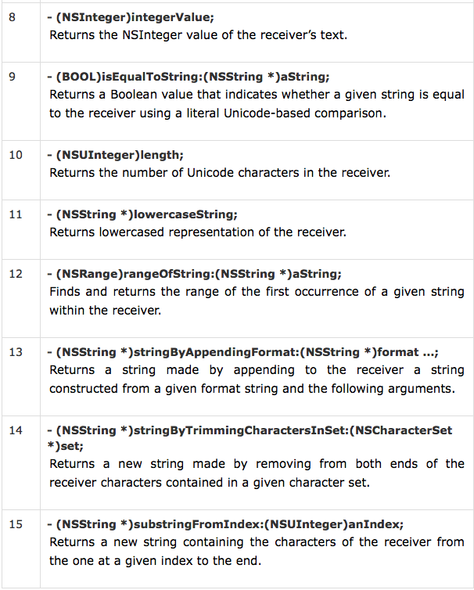
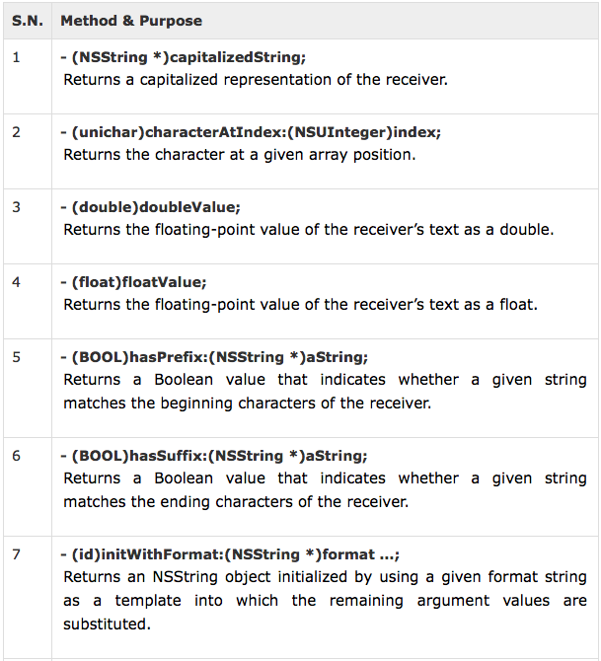
NSSTring methods
ios development training

Slide 92
NSSTring methods
ios development training

Slide 93
NSSTring Example
ios development training
#import <Foundation/Foundation.h>
int main () {
@autoreleasepool {
NSString *str1 = @"Hello";
NSString *str2 = @"World";
NSString *str3;
int len ;
/* uppercase string */
str3 = [str2 uppercaseString];
NSLog(@"Uppercase String : %@\n", str3 );
/* concatenates str1 and str2 */
str3 = [str1 stringByAppendingFormat:@"World"];
NSLog(@"Concatenated string: %@\n", str3 );
/* total length of str3 after concatenation */
len = [str3 length];
NSLog(@"Length of Str3 : %d\n", len );
/* InitWithFormat */
str3 = [[NSString alloc] initWithFormat:@"%@ %@",str1,str2];
NSLog(@"Using initWithFormat: %@\n", str3 );
}
return 0;
}

Slide 94
Structures
ios development training
struct [structure tag] {
member definition;
member definition;
...
member definition;
} [one or more structure variables];
Structure is another user-defined data type available in Objective-C programming which allows you to combine data items of different kinds.
Structures are used to represent a record, Suppose you want to keep track of your books in a library. You might want to track the following attributes about each book:
Title
Author
Subject
Book ID
struct Books {
NSString *title;
NSString *author;
NSString *subject;
int book_id;
} book;

Slide 95
Type casting
ios development training
Type casting is a way to convert a variable from one data type to another data type. For example, if you want to store a long value into a simple integer then you can type cast long to int. You can convert values from one type to another explicitly using the cast operator as follows:
(type_name) expression
#import <Foundation/Foundation.h>
int main() {
int sum = 17, count = 5;
CGFloat mean;
mean = (CGFloat) sum / count;
NSLog(@"Value of mean : %f\n", mean );
return 0;
}

Slide 96
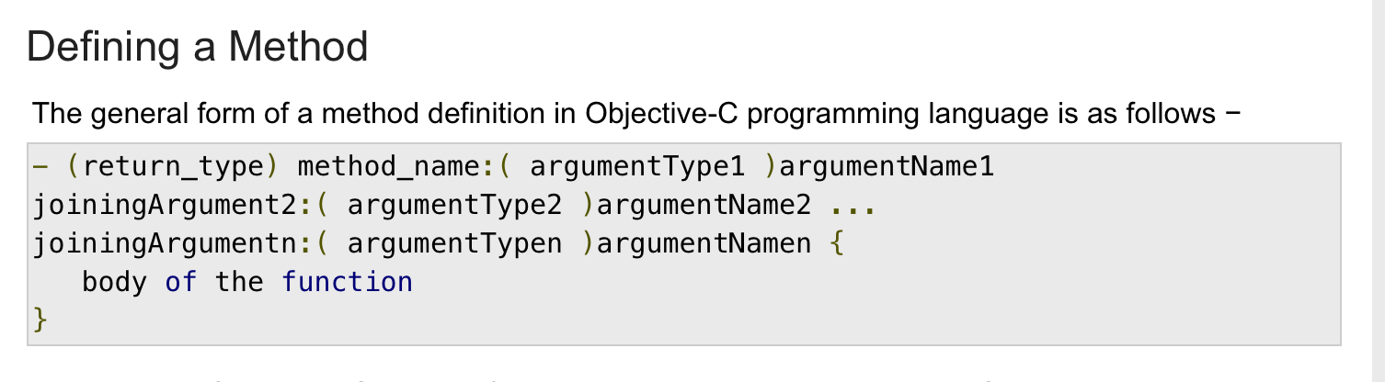
Methods/functions
ios development training
A function is a group of statements that together perform a task. Every Objective-C program has one C function, which is main(), and all of the most trivial programs can define additional functions.
You can divide up your code into separate functions. How you divide up your code among different functions is up to you, but logically the division usually is so each function performs a specific task.
A function declaration tells the compiler about a function's name, return type, and parameters. A function definition provides the actual body of the function.
Basically in Objective-C, we call the function as method.
The Objective-C foundation framework provides numerous built-in methods that your program can call. For example, method appendString() to append string to another string.
A method is known with various names like a function or a sub-routine or a procedure, etc.

Slide 97
Methods/functions
ios development training
A method definition in Objective-C programming language consists of a method header and a method body. Here are all the parts of a method −
Return Type − A method may return a value. The return_type is the data type of the value the function returns. Some methods perform the desired operations without returning a value. In this case, the return_type is the keyword void.
Method Name − This is the actual name of the method. The method name and the parameter list together constitute the method signature.
Arguments − A argument is like a placeholder. When a function is invoked, you pass a value to the argument. This value is referred to as actual parameter or argument. The parameter list refers to the type, order, and number of the arguments of a method. Arguments are optional; that is, a method may contain no argument.
Joining Argument − A joining argument is to make it easier to read and to make it clear while calling it.
Method Body − The method body contains a collection of statements that define what the method does.

Slide 98
End of day 1.
Thank you

